Slide 1
Applied Statistical Analysis
EDUC 6050
Week 6
Finding clarity using data

Slide 2
Today
Hypothesis Testing with ANOVA
One-Way
Two-Way

Slide 9
ANalysis Of VAriance
It is a whole class of methods
Generally used with experimental designs
Has similar assumptions to t-test
Gives an “omnibus” result
 | Sum of Squares | df | Mean Square | F | p
Children | 26.8 | 3 | 8.92 | 2.38 | .087
Residuals | 127.5 | 34 | 3.75

Slide 10
The F statistic
Notes:
F goes from 0 to positive infinite
Is based on two different degrees of freedom
Only one tail

Slide 11
There are several types

Slide 12
General
Requirements
ID | Outcome | Group
1 | 8 | 1
2 | 8 | 1
3 | 9 | 1
4 | 7 | 1
5 | 7 | 2
6 | 9 | 2
7 | 5 | 2
8 | 5 | 2
Need a DV on an interval/ratio scale,
IV defines 2+ different groups (or time points)

Slide 13
General
Requirements
ID | Time 1 | Time 2
1 | 8 | 7
2 | 8 | 8
3 | 9 | 6
4 | 7 | 6
5 | 7 | 8
6 | 9 | 5
7 | 5 | 3
8 | 5 | 3
Need a DV on an interval/ratio scale,
IV defines 2+ different groups (or time points)

Slide 14
Hypothesis Testing with ANOVA
The same 6 step approach!
Examine Variables to Assess Statistical Assumptions
State the Null and Research Hypotheses (symbolically and verbally)
Define Critical Regions
Compute the Test Statistic
Compute an Effect Size and Describe it
Interpreting the results

Slide 15
Examine Variables to Assess Statistical Assumptions
1
Basic Assumptions
Independence of data
Appropriate measurement of variables for the analysis
Normality of distributions
Homogeneity of variance

Slide 16
Examine Variables to Assess Statistical Assumptions
1
Basic Assumptions
Independence of data
Appropriate measurement of variables for the analysis
Normality of distributions
Homogeneity of variance
Individuals are independent of each other (one person’s scores does not affect another’s)

Slide 17
Examine Variables to Assess Statistical Assumptions
1
Basic Assumptions
Independence of data
Appropriate measurement of variables for the analysis
Normality of distributions
Homogeneity of variance
Here we need interval/ratio DV
Notes:
For F-test, DV needs to be interval/ratio

Slide 18
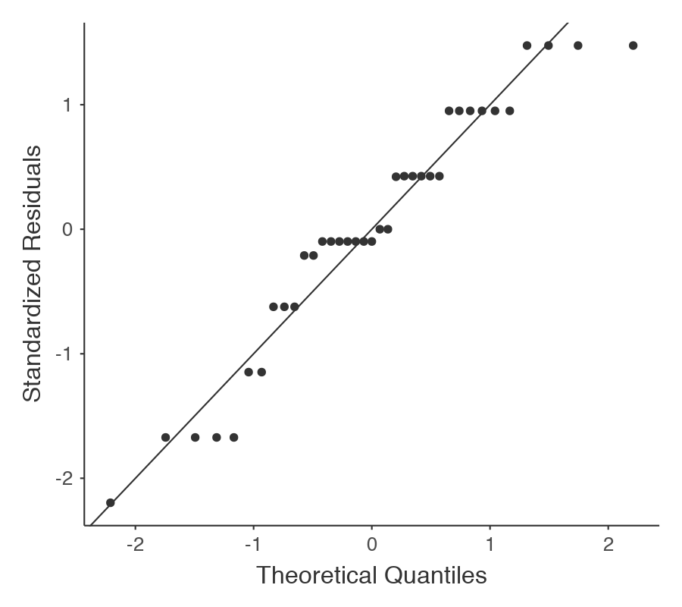
Examine Variables to Assess Statistical Assumptions
1
Basic Assumptions
Normality of the residuals
Independence of data
Appropriate measurement of variables for the analysis
Normality of distributions
Homogeneity of variance

Slide 19
Examine Variables to Assess Statistical Assumptions
1
F | df1 | df2 | P
2.86 | 3 | 34 | .051
Basic Assumptions
Independence of data
Appropriate measurement of variables for the analysis
Normality of distributions
Homogeneity of variance
The variances of groups should be equal (not strict if each group has similar sample sizes)

Slide 20
Examine Variables to Assess Statistical Assumptions
1
Examining the Basic Assumptions
Independence: random sample
Appropriate measurement: know what your variables are
Normality: Histograms, Q-Q, skew and kurtosis
Homogeneity: Levene’s Test

Slide 21
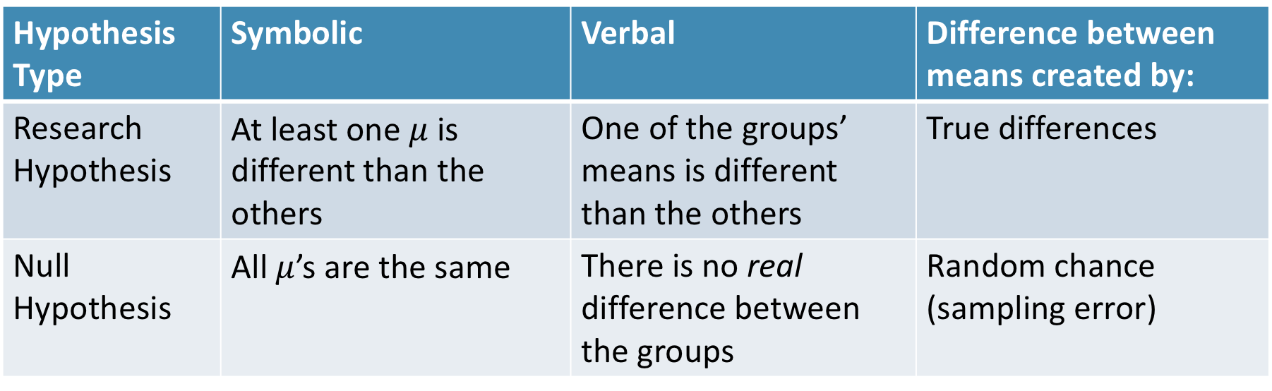
State the Null and Research Hypotheses (symbolically and verbally)
2
Hypothesis Type | Symbolic | Verbal | Difference between means created by:
Research Hypothesis | At least one $μ$ is different than the others | One of the groups’ means is different than the others | True differences
Null Hypothesis | All $μ$’s are the same | There is no real difference between the groups | Random chance (sampling error)
Notes:
Null and research hypotheses are mutually exclusive (they cover all possible outcomes)

Slide 22
Define Critical Regions
3
How much evidence is enough to believe the null is not true?
Before analyzing the data, we define the critical regions (generally based on an alpha = .05)

Slide 23
Define Critical Regions
3
We decide on an alpha level first
Then calculate the critical value (based on sample size)

Slide 24
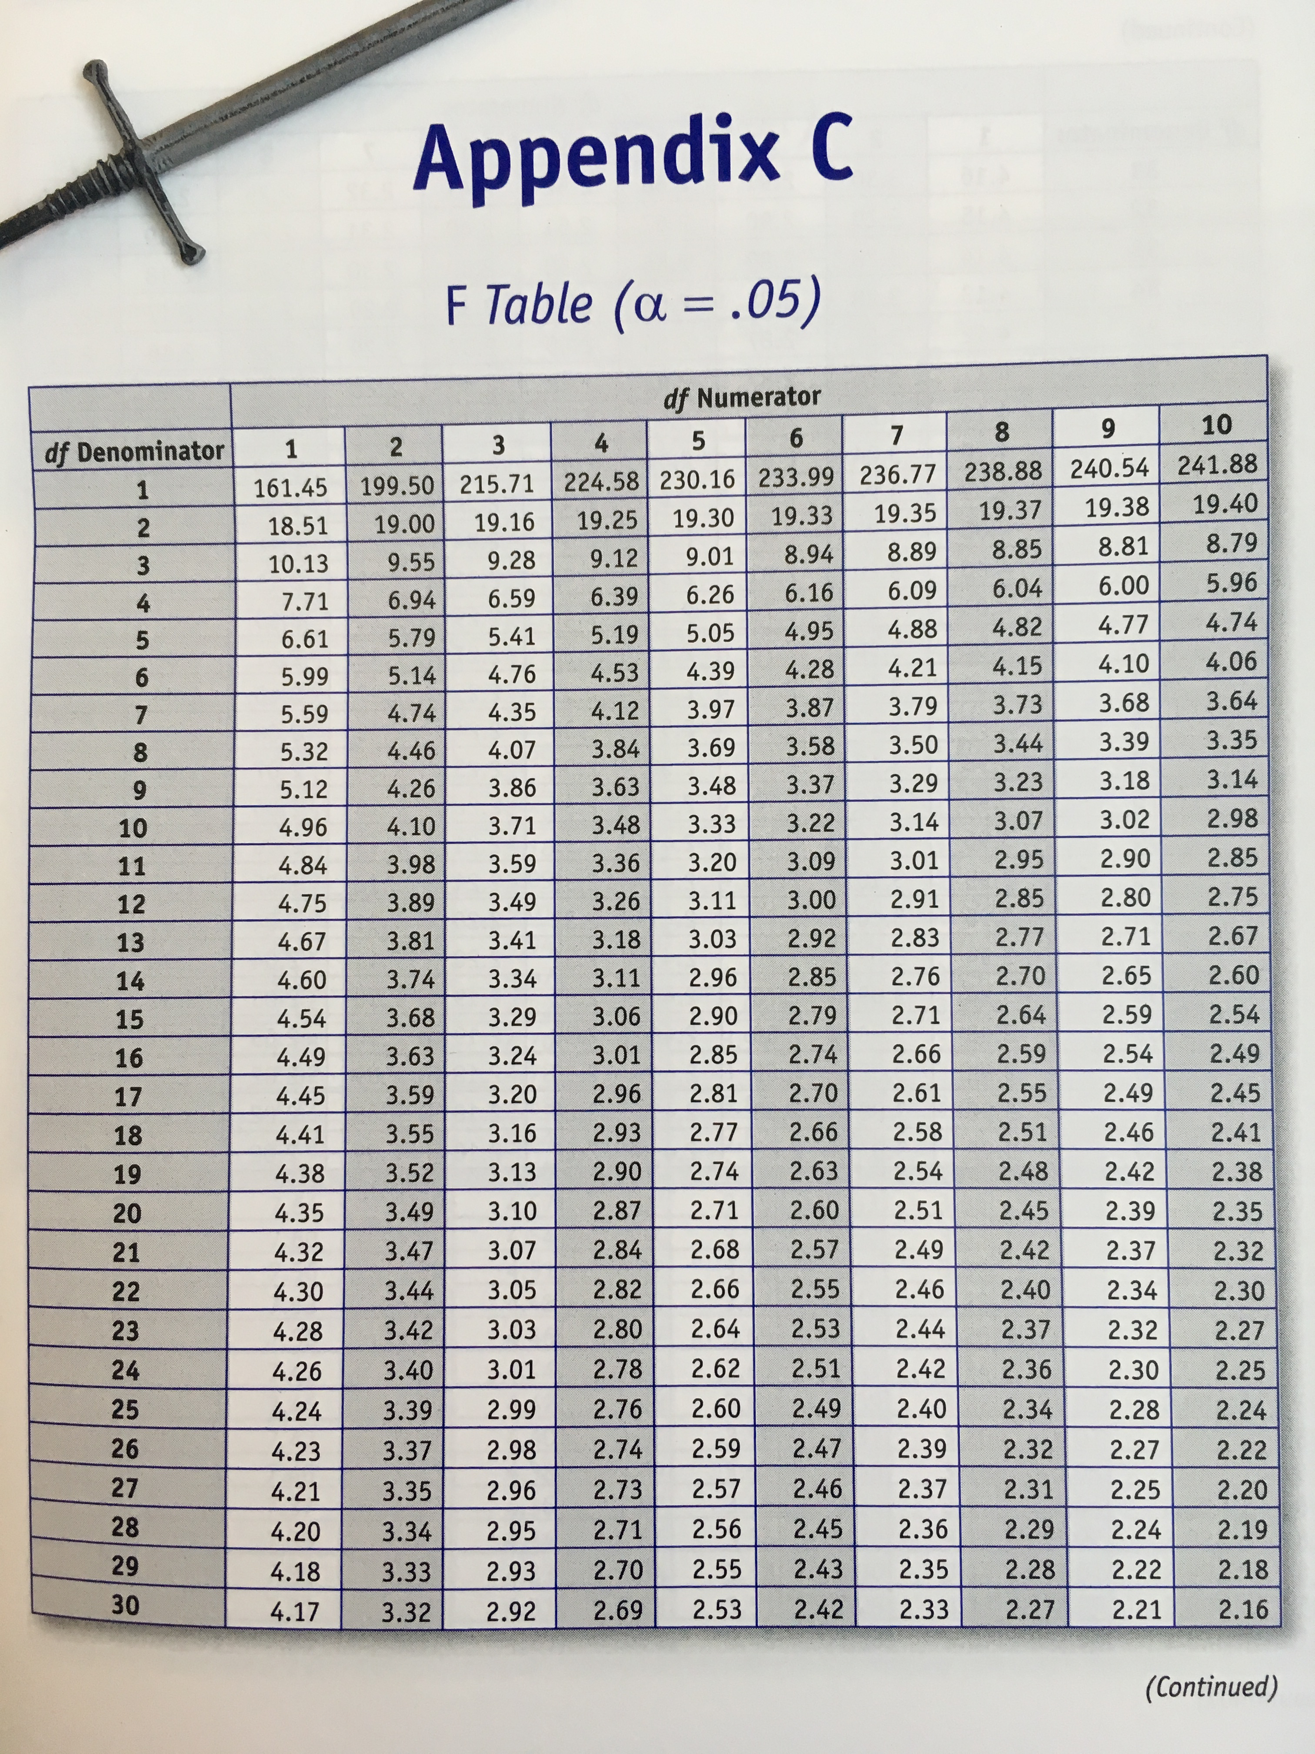

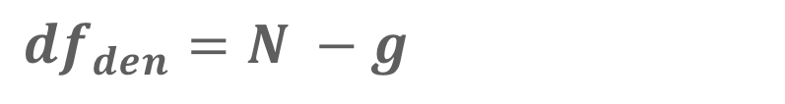
Define Critical Regions
3
We decide on an alpha level first
Then calculate the critical value (based on sample size)
Use the table in the book
Base on alpha and 2 specific df’s
$df_{num}=g −1$ where g is number of groups
$df_{den}=N −g$
Notes:
$df_{num}$ is also knowns as $df_{between}$
$df_{den}$ is also knowns as $df_{within}$ or $df_{error}$ or $df_{residual}$

Slide 25


Define Critical Regions
3
We decide on an alpha level first
Then calculate the critical value (based on sample size)
$$F_{critical}\left(2, 29\right)=3.33$$
So our critical region is defined as:
$$α= .05$$
$$F_{critical}\left(2, 29\right)=3.33$$
Notes:
If our computed t value is beyond 2.05 OR our p-value is below .05, then we REJECT the null (the findings are statistically significant)

Slide 26
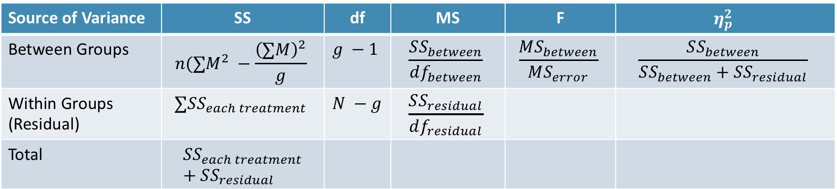
Compute the Test Statistic
4
Source of Variance | SS | df | MS | F | $$η_{p}^{2}$$
Between Groups | $$n(∑M^{2} −\frac{{\left(∑M\right)}^{2}}{g}$$ | $$g −1$$ | $$\frac{SS_{between}}{df_{between}}$$ | $$\frac{MS_{between}}{MS_{error}}$$ | $$\frac{SS_{between}}{SS_{between}+SS_{residual}}$$
Within Groups (Residual) | $$∑SS_{each treatment}$$ | $$N −g$$ | $$\frac{SS_{residual}}{df_{residual}}$$
Total | $$SS_{each treatment}+SS_{residual}$$

Slide 27
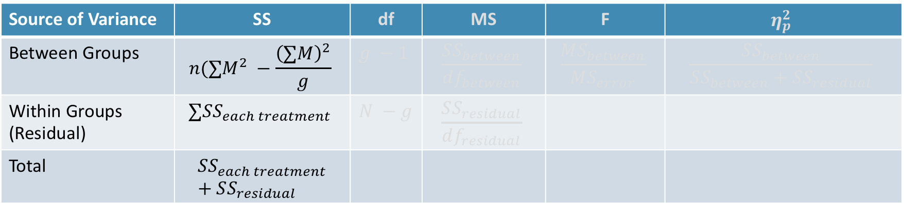
Compute the Test Statistic
4
“Sum of Squares” – adding up all the squared deviations (essentially like SD)
Source of Variance | SS | df | MS | F | $$η_{p}^{2}$$
Between Groups | $$n(∑M^{2} −\frac{{\left(∑M\right)}^{2}}{g}$$ | $$g −1$$ | $$\frac{SS_{between}}{df_{between}}$$ | $$\frac{MS_{between}}{MS_{error}}$$ | $$\frac{SS_{between}}{SS_{between}+SS_{residual}}$$
Within Groups (Residual) | $$∑SS_{each treatment}$$ | $$N −g$$ | $$\frac{SS_{residual}}{df_{residual}}$$
Total | $$SS_{each treatment}+SS_{residual}$$
Gets split by where the variation is coming from
Between the groups (the differences in the groups)
Within the groups

Slide 28
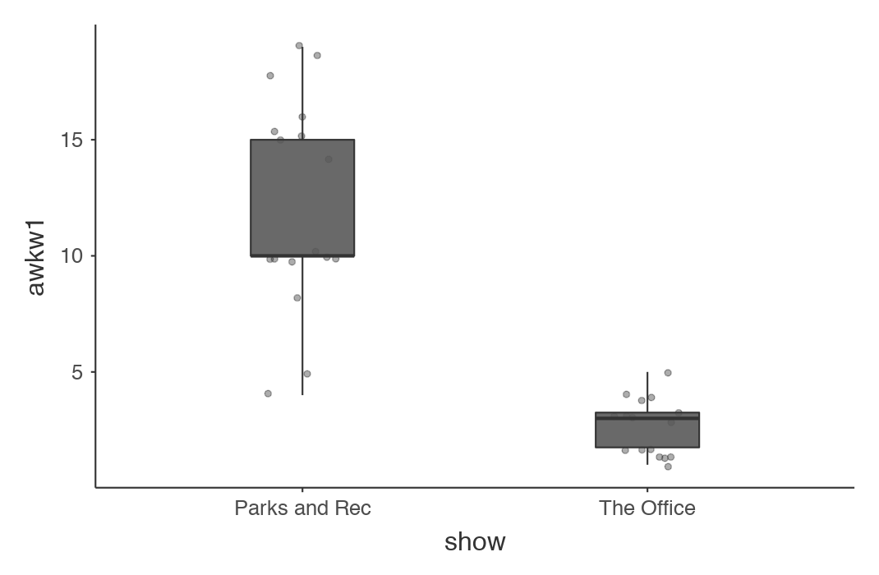
Compute the Test Statistic
4
Within group variation (residual)
Outcome
Within group variation (residual)

Slide 29
Compute the Test Statistic
4
Outcome
Between Groups variation

Slide 30
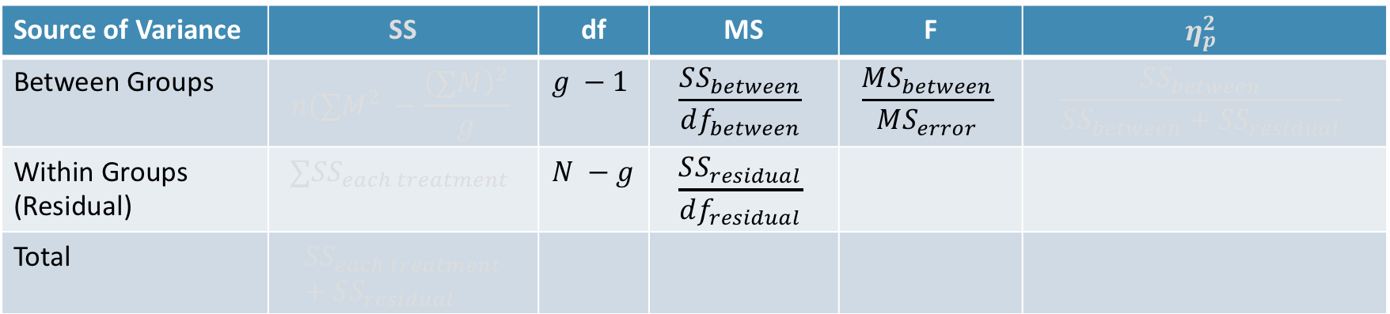
Compute the Test Statistic
4
Source of Variance | SS | df | MS | F | $$η_{p}^{2}$$
Between Groups | $$n(∑M^{2} −\frac{{\left(∑M\right)}^{2}}{g}$$ | $$g −1$$ | $$\frac{SS_{between}}{df_{between}}$$ | $$\frac{MS_{between}}{MS_{error}}$$ | $$\frac{SS_{between}}{SS_{between}+SS_{residual}}$$
Within Groups (Residual) | $$∑SS_{each treatment}$$ | $$N −g$$ | $$\frac{SS_{residual}}{df_{residual}}$$
Total | $$SS_{each treatment}+SS_{residual}$$
Is the amount of difference in the means big compared to how much variability there is in the groups?
These are all ratios
Answers

Slide 31
Compute the Test Statistic
4
F-statistic and p-value tell you if one of the groups is different than the others
Post Hoc Tests
But it doesn’t tell you which ones are different...

Slide 32
Compute the Test Statistic
4
Post Hoc Tests
(or Contrasts)
Post hoc usually refers to comparing all groups with each other (and making an adjustment for the multiple comparisons)
Contrasts usually refers to comparing some of the groups with each other (or a combination of groups with each other)

Slide 33
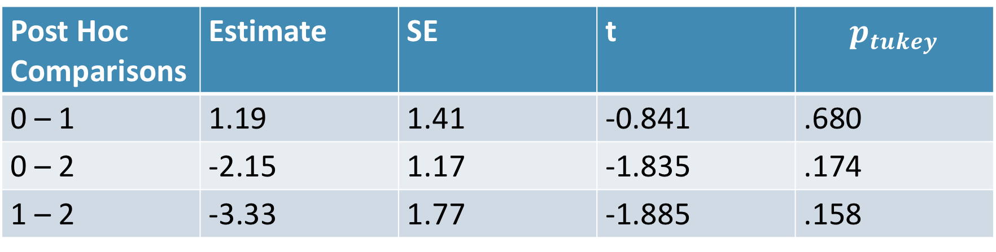
Compute the Test Statistic
4
Post Hoc Tests (or Contrasts)
Contrasts | Estimate | SE | t | p
1 – 0 | -1.19 | 1.41 | -0.841 | .406
2 – 0 | 2.15 | 1.17 | 1.835 | .075
Post Hoc Comparisons | Estimate | SE | t | $$p_{tukey}$$
0 – 1 | 1.19 | 1.41 | -0.841 | .680
0 – 2 | -2.15 | 1.17 | -1.835 | .174
1 – 2 | -3.33 | 1.77 | -1.885 | .158

Slide 34
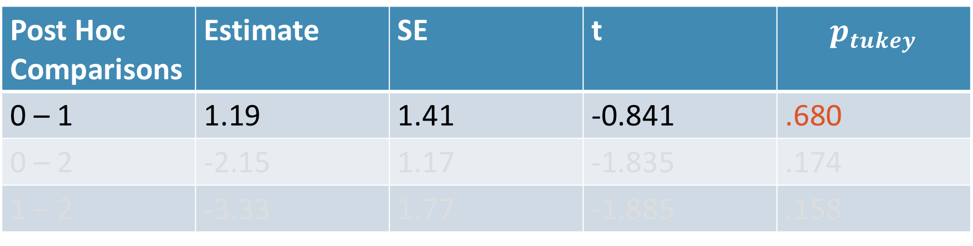
Compute the Test Statistic
4
Post Hoc Tests (or Contrasts)
Contrasts | Estimate | SE | t | p
1 – 0 | -1.19 | 1.41 | -0.841 | .406
1 – 0 | 2.15 | 1.17 | 1.835 | .075
Post Hoc Comparisons | Estimate | SE | t | $$p_{tukey}$$
0 – 1 | 1.19 | 1.41 | -0.841 | .680
0 – 2 | -2.15 | 1.17 | -1.835 | .174
1 – 2 | -3.33 | 1.77 | -1.885 | .158

Slide 35
Compute the Test Statistic
4
Source of Variance | SS | df | MS | F | $$η_{p}^{2}$$
Between Groups | $$n(∑M^{2} −\frac{{\left(∑M\right)}^{2}}{g}$$ | $$g −1$$ | $$\frac{SS_{between}}{df_{between}}$$ | $$\frac{MS_{between}}{MS_{error}}$$ | $$\frac{SS_{between}}{SS_{between}+SS_{residual}}$$
Within Groups (Residual) | $$∑SS_{each treatment}$$ | $$N −g$$ | $$\frac{SS_{residual}}{df_{residual}}$$
Total | $$SS_{each treatment}+SS_{residual}$$
Answers
How much of the variability is accounted for by the groups vs everything else?

Slide 36

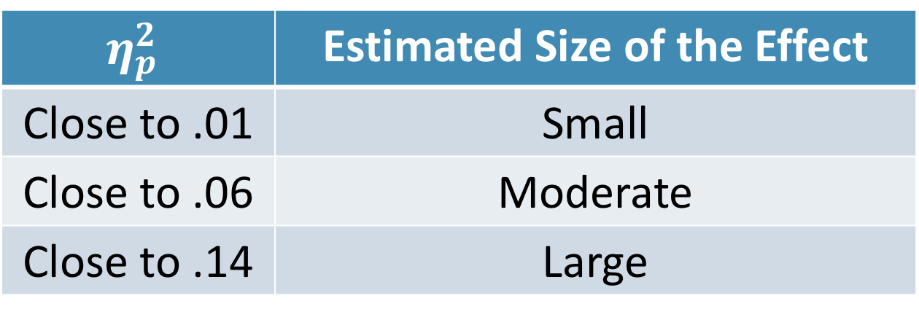
Compute an Effect Size and Describe it
5
One of the main effect sizes for ANOVA is “Eta Squared”
$$η_{p}^{2}=\frac{SS_{between}}{SS_{between}+SS_{residual}}$$
$$η_{p}^{2}$$ | Estimated Size of the Effect
Close to .01 | Small
Close to .06 | Moderate
Close to .14 | Large
Notes:
Can also use Cohen’s d here as well for each mean difference

Slide 37
Interpreting the results
6
Put your results into words
Use the example around page 382 as a template

Slide 38
One-Way and Two-Way

Slide 39
One-Way vs. Two-Way
One-way ANOVA has one predictor
Two-way ANOVA has two predictors
Tests for any differences across the groups on one predictor
Tests for any differences across the groups for both predictors (and their combinations)
“Interaction”
Notes:
We don’t show a full example of a two-way ANOVA because it is just like one-way but it has multiple things we are testing:
The interaction of the two predictors
The main effects of each predictor

Slide 40
Interactions
When the effect of a predictor depends on another
Notes:
Sometimes the effect of one of the predictors depends on the other predictor

Slide 41
Questions?
Please post them to the discussion board before class starts
End of Pre-Recorded Lecture Slides

Slide 42
In-class discussion
slides

Slide 43
https://youtu.be/h4MhbkWJzKk

Slide 44
Application
Example Using
The Office/Parks and Rec Data Set
Hypothesis Test with ANOVA
(One-Way and Two-Way)

